Slide 1
The Battle of Neighbourhoods
By,
Parshad Sabara

Slide 2
Introduction:
The purpose of this Project is to help people in exploring better facilities around their neighborhood. It will help people making smart and efficient decision on selecting great neighborhood out of numbers of other neighborhoods in Scarborough, Toranto.
Lots of people are migrating to various states of Canada and needed lots of research for good housing prices and reputed schools for their children. This project is for those people who are looking for better neighborhoods. For ease of accessing to Cafe, School, Super market, medical shops, grocery shops, mall, theatre, hospital, like minded people, etc.
This Project aim to create an analysis of features for a people migrating to Scarborough to search a best neighborhood as a comparative analysis between neighborhoods. The features include median housing price and better school according to ratings, crime rates of that particular area, road connectivity, weather conditions, good management for emergency, water resources both freash and waste water and excrement conveyed in sewers and recreational facilities.
It will help people to get awareness of the area and neighborhood before moving to a new city, state, country or place for their work or to start a new fresh life.
Notes:
Insert a map of your country.

Slide 3
Data selection
Data Link: https://en.wikipedia.org/wiki/List_of_postal_codes_of_Canada:_M
Will use Scarborough dataset which we scrapped from wikipedia on Week 3. Dataset consisting of latitude and longitude, zip codes.
Notes:
Insert a picture of one of the geographic features of your country.

Slide 4
Data selection
Foursquare API Data:
We will need data about different venues in different neighborhoods of that specific borough. In order to gain that information we will use "Foursquare" locational information. Foursquare is a location data provider with information about all manner of venues and events within an area of interest. Such information includes venue names, locations, menus and even photos. As such, the foursquare location platform will be used as the sole data source since all the stated required information can be obtained through the API.
After finding the list of neighborhoods, we then connect to the Foursquare API to gather information about venues inside each and every neighborhood. For each neighborhood, we have chosen the radius to be 100 meter.
The data retrieved from Foursquare contained information of venues within a specified distance of the longitude and latitude of the postcodes. The information obtained per venue as follows:
Neighborhood
Neighborhood Latitude
Neighborhood Longitude
Venue
Name of the venue e.g. the name of a store or restaurant
Venue Latitude
Venue Longitude
Venue Category
Notes:
Insert a picture of one of the geographic features of your country.

Slide 5
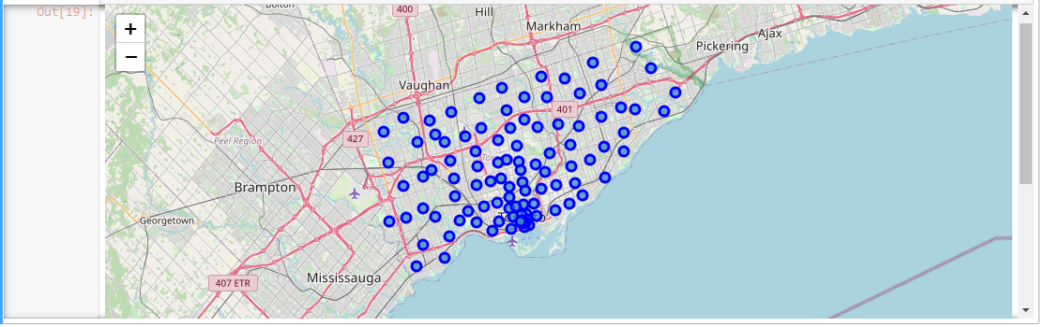
Data selection
Map of Scarborough
Notes:
Insert a picture of one of the geographic features of your country.

Slide 6
Methodology
Clustering Approach:
To compare the similarities of two cities, we decided to explore neighborhoods, segment them, and group them into clusters to find similar neighborhoods in a big city like New York and Toronto. To be able to do that, we need to cluster data which is a form of unsupervised machine learning: k-means clustering algorithm.
Notes:
Insert a picture of an animal and or plant found in your country.

Slide 7
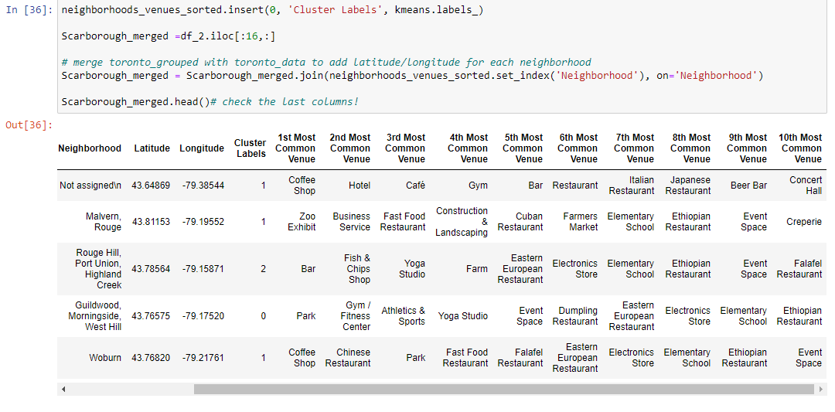
Methodology
Using K-Means Clustering Approach
Notes:
Insert a picture of an animal and or plant found in your country.

Slide 8
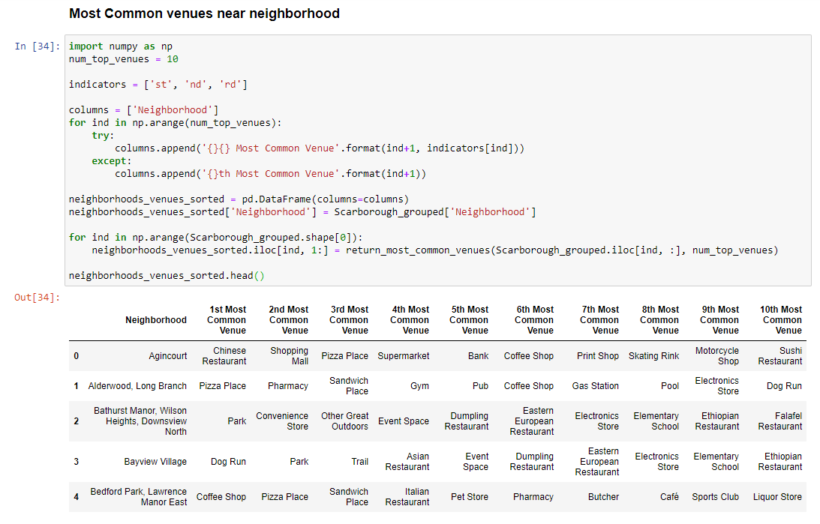
Methodology
Most Common venues near Neighborhood
Notes:
Insert a picture of an animal and or plant found in your country.

Slide 9
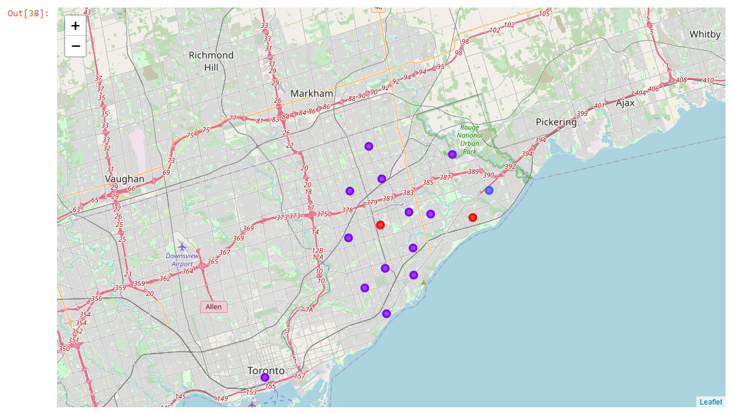
Results
Map of Clusters in Scarborough
Notes:
Insert a picture of an animal and or plant found in your country.

Slide 10
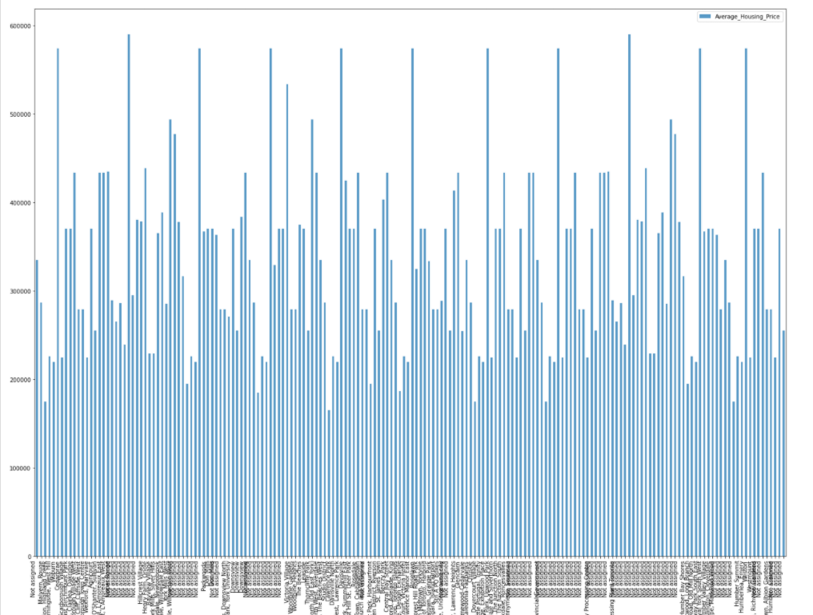
Results
Average Housing Price by Clusters in Scarborough
Notes:
Insert a picture of an animal and or plant found in your country.

Slide 11
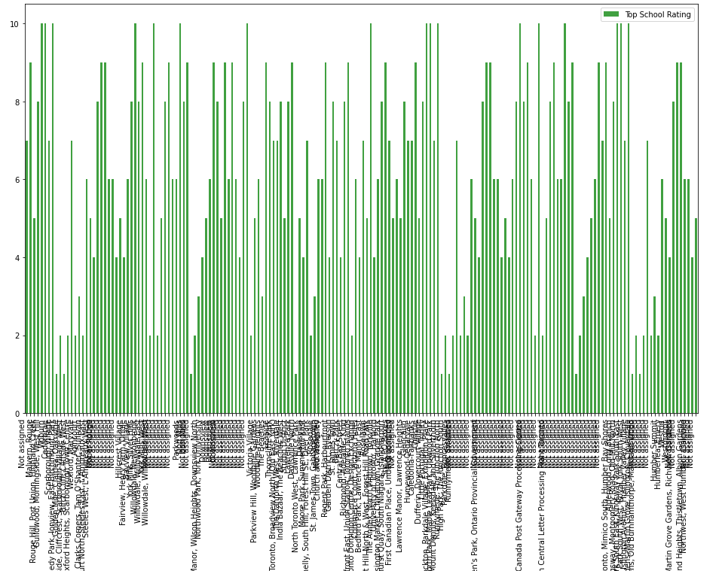
Results
School Ratings by Clusters in Scarborough
Notes:
Insert a picture of an animal and or plant found in your country.

Slide 12
Discussion
Problem Which Tried to Solve:
The major purpose of this project, is to suggest a better neighborhood in a new city for the person who are shiffting there. Social presence in society in terms of like minded people. Connectivity to the airport, bus stand, city center, markets and other daily needs things nearby.
Sorted list of house in terms of housing prices in a ascending or descending order
Sorted list of schools in terms of location, fees, rating and reviews
Notes:
Add key points in the history of your country to the timeline.

Slide 13
Conclusion
In this project, using k-means cluster algorithm I separated the neighborhood into 10(Ten) different clusters and for 103 different lattitude and logitude from dataset, which have very-similar neighborhoods around them. Using the charts above results presented to a particular neighborhood based on average house prices and school rating have been made.
I feel rewarded with the efforts and believe this course with all the topics covered is well worthy of appreciation. This project has shown me a practical application to resolve a real situation that has impacting personal and financial impact using Data Science tools. The mapping with Folium is a very powerful technique to consolidate information and make the analysis and decision better with confidence.
Notes:
Add key points in the history of your country to the timeline.

